Slide 1

Battle of Neighborhoods
New York City, NY
BY
Manisha Agarwal

Slide 2
Problem Statement
To recommend the best neighborhood to live, to buy a house, to rent an apartment or build a restaurant etc in New york.
To understand the similarities and differences between the neighborhoods using Unsupervised K-Mean Clustering Algorithm.

Slide 3
Objective
Collecting the top trending venues in the using Foursquare API(Beautiful Soup, http request)
Forming neighborhood clusters based on venue categories using unsupervised k-mean clustering algorithm(sklearn)
Identifying and understanding the similarities and differences between two chosen neighborhoods to retrieve more insights and to conclude which neighborhood wins over other.

Slide 4
Python packages and Dependencies:
Pandas - Library for Data Analysis
NumPy – Library to handle data in a vectorized manner
JSON – Library to handle JSON files
Geopy – To retrieve Location Data
Requests – Library to handle http requests
Matplotlib – Python Plotting Module
Sklearn – Python machine learning Library
Folium – Map rendering Library

Slide 5
Work flow
Web Scraping and Data Wrangling
Top Trending Places Extraction and Clustering
Decision Making based on the clustered neighborhoods, Population Distribution, School Ratings, Median House Price Analysis

Slide 6
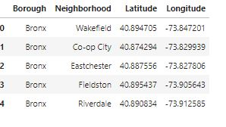

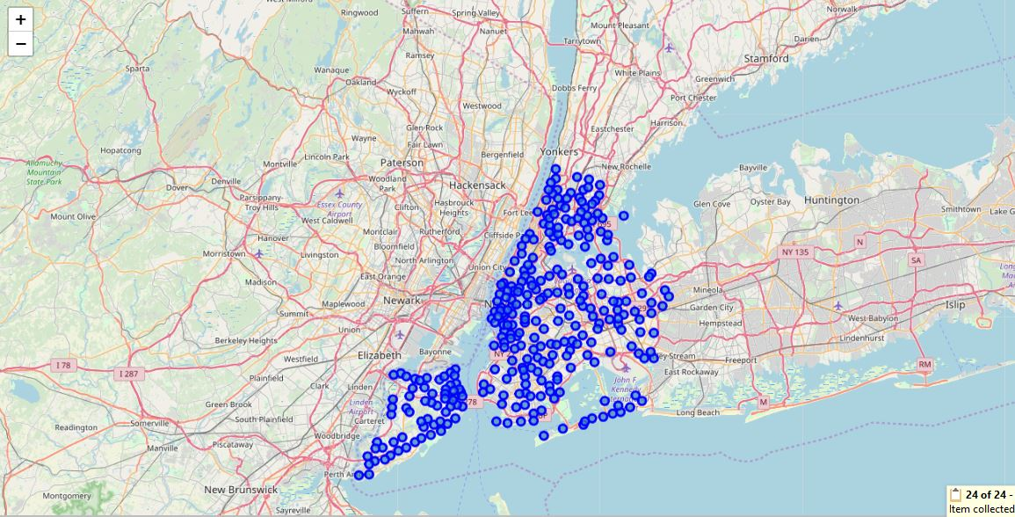
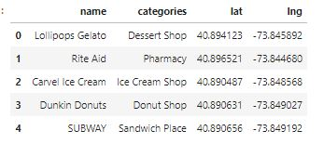
Web Scraping and Data Wrangling
Beautiful Soup
Google Maps API
Collecting Neighborhood/Postal code
http://seattlearea.com/zip-codes/
To Collect Geographical Data
Folium Visualization for New York Neighborhood

Slide 7
Venues Extraction using Four Square API and Clustering
Cluster 1
Four Square API Calls to Collect Neighborhood Venue Category and LAT/LNG
Venues Grouped by Neighborhood 341 Unique Venues
Cluster 2
One Hot Encoding to Convert Labels into Numbers
K-Means Clustering
Cluster 3
Cluster 4
Cluster 5

Slide 8
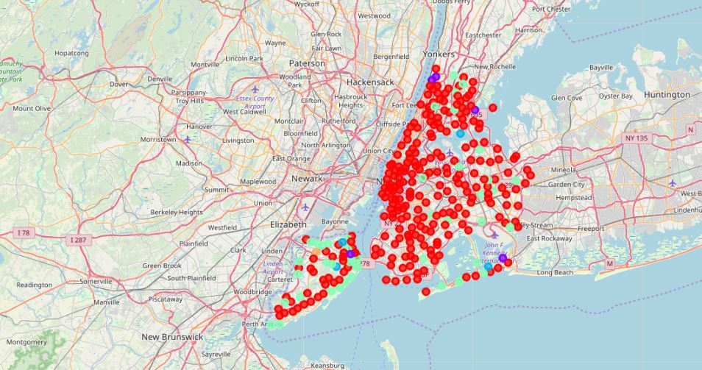
Clustering Neighborhood

Slide 9









Decision Making
Neighborhood 1
Neighborhood 2
Population Distribution Analysis
Median House Price Analysis
School Ratings Analysis
Cluster Analysis
Winning Neighborhood

Slide 10
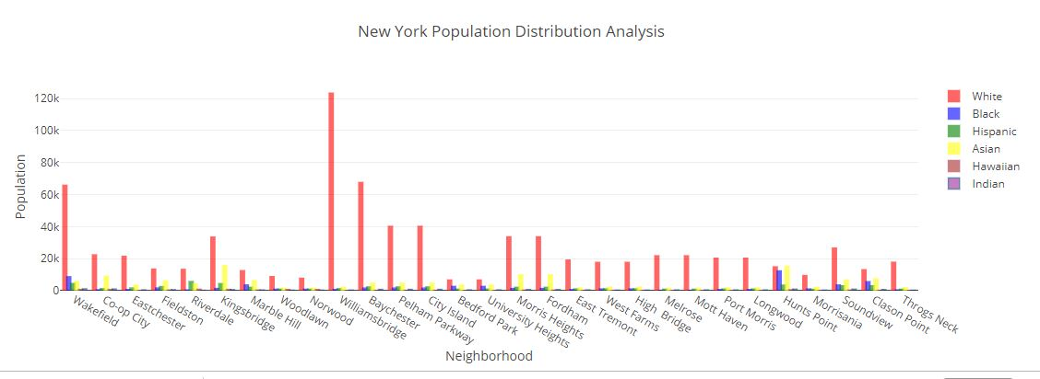
POPULATION DISTRIBUTION

Slide 11
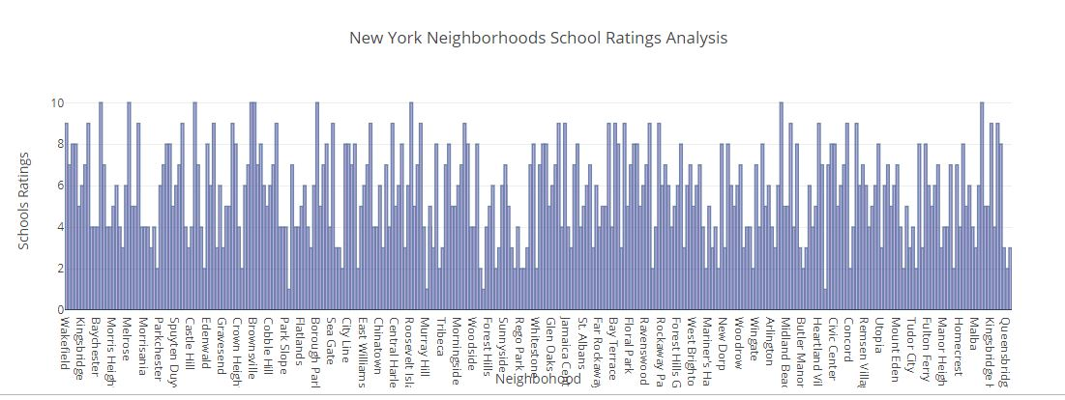
AVERAGE SCHOOL RATINGS

Slide 12
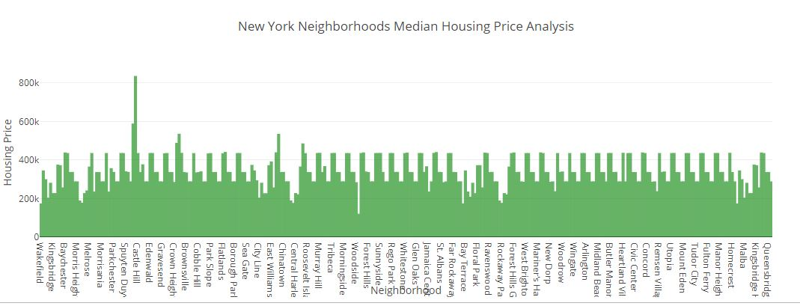
MEDIAN HOUSE PRICE

Slide 13
Comparison between Neighborhoods – New York
Wakefield and Marble Hill
Now lets compare 2 neighborhoods to choose one that best matches our requirements as given below
More Indian Population
Higher School Rating
Reasonable Housing Price in the Range of 150k to 300k
Great Amenities
Comfortable Neighborhoods

Slide 14
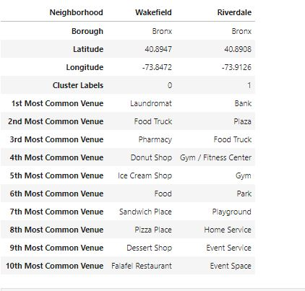
Neighborhood Venues

Slide 15
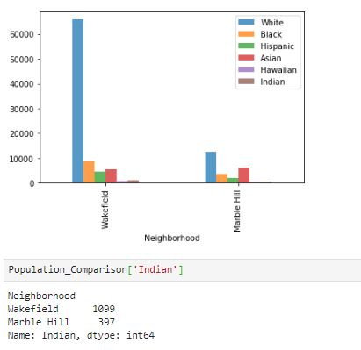
Population distribution

Slide 16
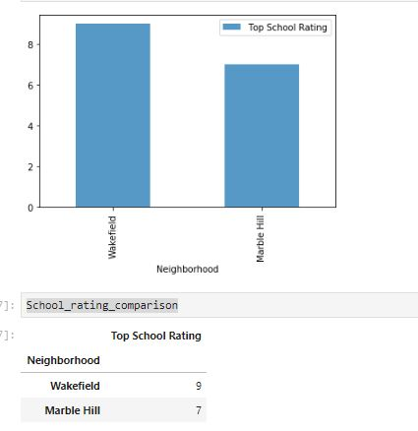
School ratings

Slide 17
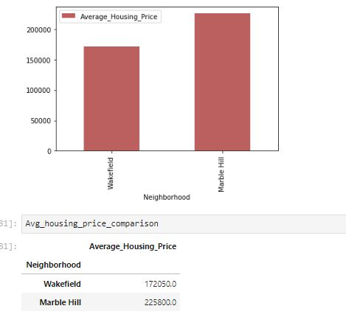
Average housing price

Slide 18





Conclusion
This Analysis concludes that the two places of New York Wakefield , Marble Hill both has great amenities and locality.
Wakefield has the higher number of Indian population
Good school rating of 9
Reasonable average housing price of around 172k
Also top 10 common venues shows Wakefield Laundromat, Pharmacy, Food Truck, Clothing Store , Pizza Place, Donut Shop and many more.
Hence Wakefield wins over Marble Hill!

